Slide 1
Automated Ecommerce login using Selenium and Data Extraction using RAG Model
Sai Rahul.T
Under the Guidance of :
Mr Sankar
Vice Presedent
Mobius Knowledge Services

Slide 2
Agenda
Introduction
Technology stack
Design of the solution
Implementation – Explain in detail with snapshots
Best Practices Learned
Conclusion
References

Slide 3
Introduction
Internship Duration: June 19, 2024 - July 26, 2024
Role:Machine Learning/Software Intern
Key Projects:
Automatic Sign into ECommerce in using Selenium
Entity extraction using regular expression and RAG models

Slide 4



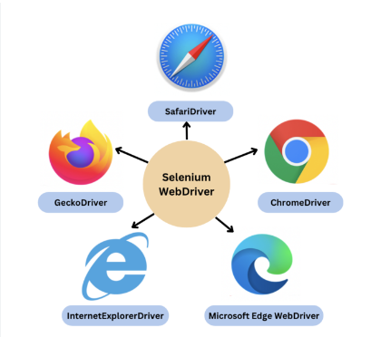
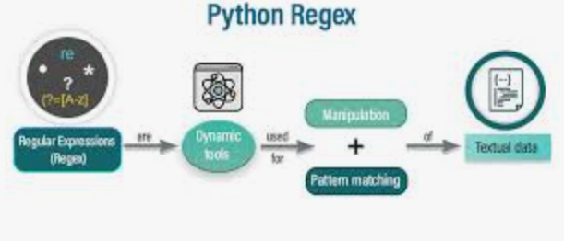

Technologies Used
Python Webdriver Manager Chromedriver
Selenium Webdriver Regular expressions RAG Pipeline

Slide 5
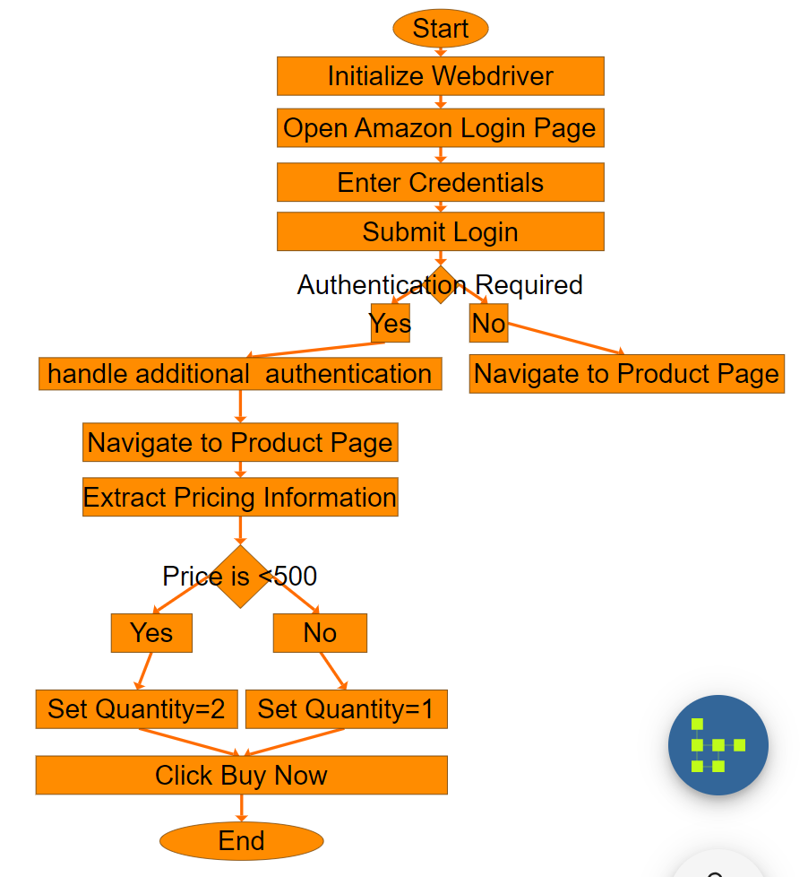
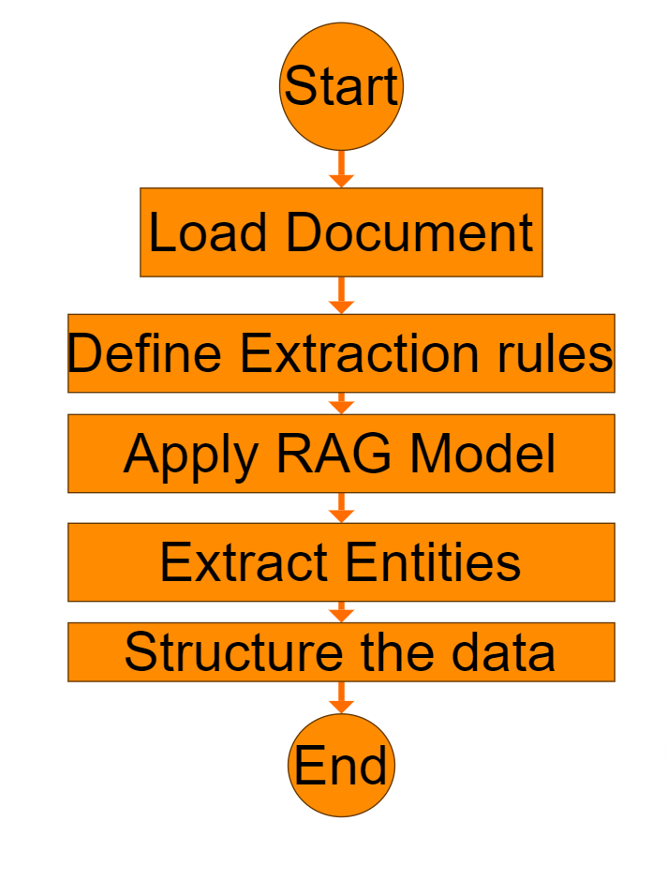
Design of Solution
The first flowchart is for automatic sign in into Amazon/Flipkart using Python Selenium
There is a condition here
First the code is run,this initiates the automatic sign in process
Then the Webdriver is initialized
After this the Amazon login Page is opened
The credentials are then entered
Then the login details are submitted
Then the authentication request occurs and when it is given a yes then the system automatically goes to product page (using url)
Then if price of the product is <500 then 2 products are added else:
Only 1 product is added and then the Add to Cart button is clicked then the Buy now button is clicked
Then the automated sign in and purchase comes to an end
The second flowchart is for entity extraction using Regex and RAG models
The document is loaded
There are 2 files, rag.py and mainscript.py
The extraction rules are defined in rag.py
Then the RAG model is applies then the entities that are required are extracted and the data is structured

Slide 6
Implementation Overview
Automatic Sign into Ecommerce website in using Selenium:This ensures automation and saves time
Entity extraction using regular expression and RAG models: This extracts important data that is needed example owner’s details in a rental agreement

Slide 7
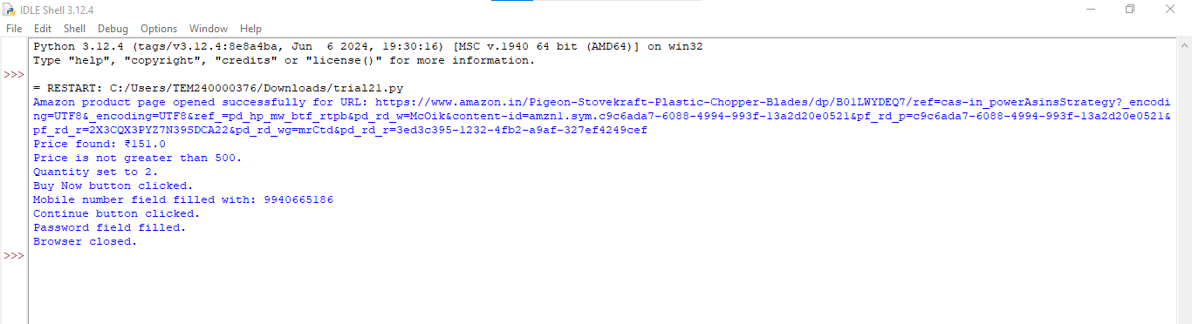
Implementation Snapshots(this snapshot is for automated sign in using selenium)

Slide 8
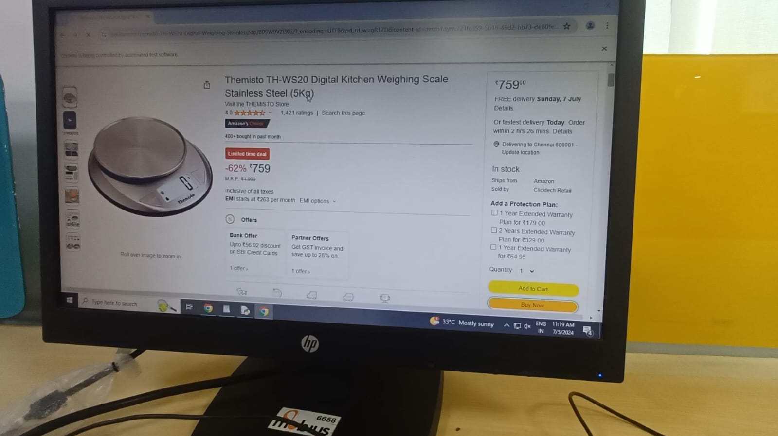
Implementation Snapshots

Slide 9
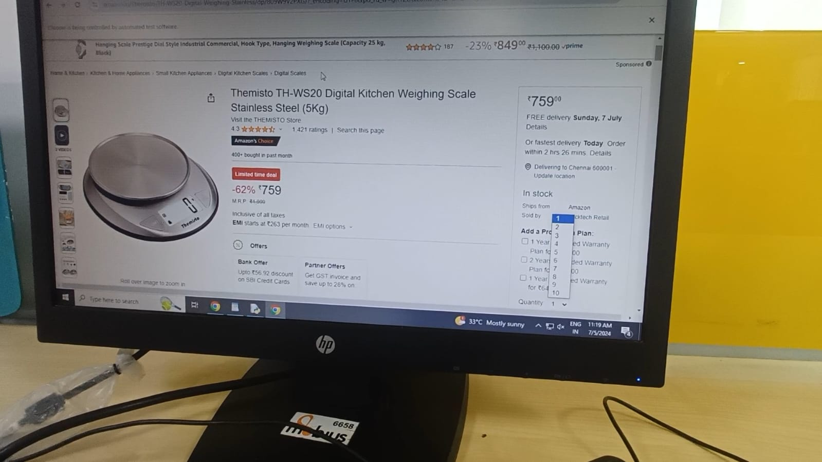
Implementation Snapshots

Slide 10
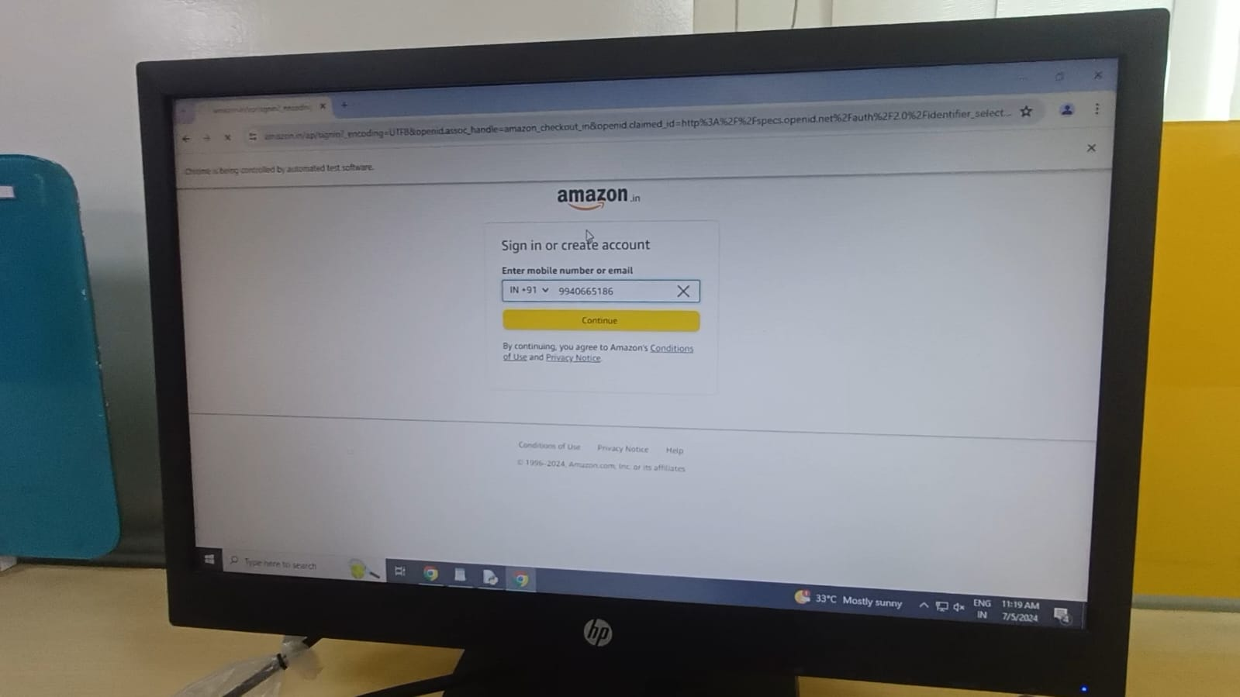
Implimentation Snapshots

Slide 11
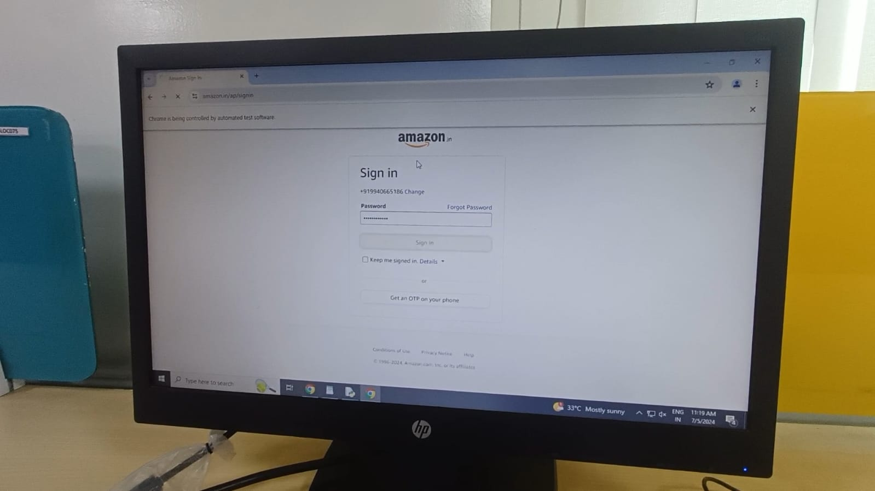
Implementation Screenshots

Slide 12
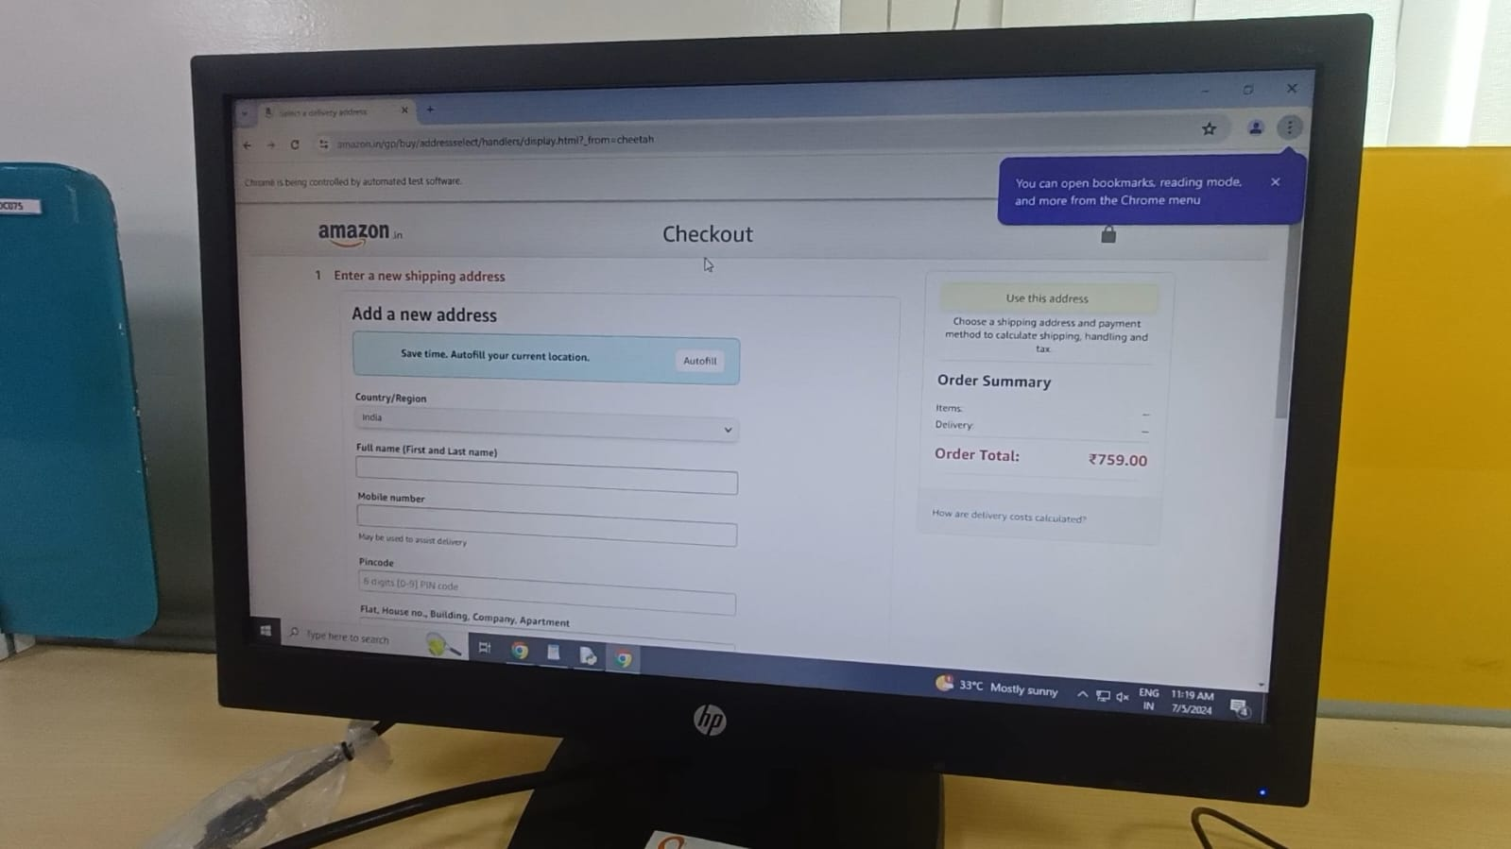
Implementation Snapshots(the sign in has taken place automatically!)

Slide 13
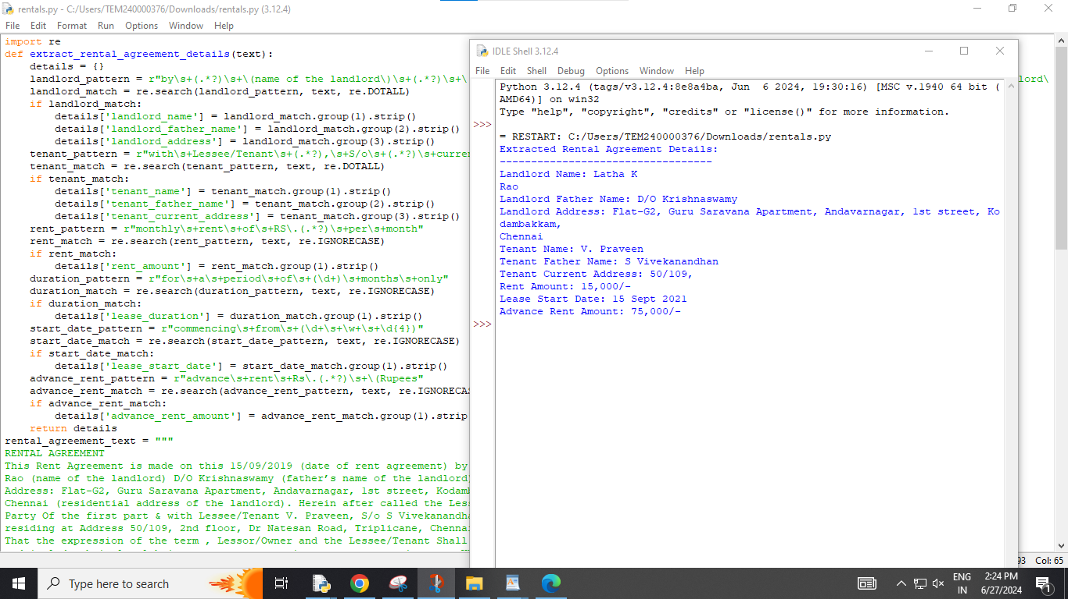
Implimentation Screenshot(entity extraction using regular expression and RAG model)

Slide 14
Best Practices
Best Practices in Text Extraction Tool
Well-Defined Regular Expressions
Create precise regex patterns to accurately extract specific data
This ensures minimal errors and relevant data extraction.
Modular Code Design
Structured the code into functions and classes
This facilitates code reuse and simplifies updates.
Testing, Validation, and Documentation
Thoroughly tesingt regex with diverse sample documents to confirm accuracy.

Slide 15
Best Practices
Best Practices in Selenium Automation Script
Effective Error Handling
Using try-except blocks to manage exceptions like NoSuchElementException and TimeoutException.
Use of Explicit Waits
Implement WebDriverWait with conditions such as EC.presence_of_element_located to ensure element availability.
Comprehensive Logging and Retry Mechanisms
Maintain detailed logs for debugging and incorporate retry logic to handle transient issues.

Slide 16
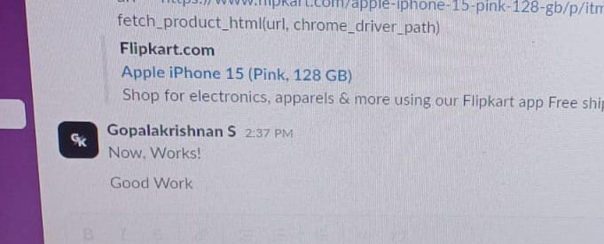
Outcomes
Implemented a mechanism that automatically signs into ecommerce websites and enters the number of products to be purchased based on the cost(using selinium)
Implimented an entity extraction software using regular expressions and RAG model
I also received appreciation from my senior for my work which had been encouraging

Slide 17
Conclusion
Skill Development:RAG model,Regular expressions,Automated sign in using selenium
Key Takeaways:Automation of tasks,extraction of data from various texts,Coding with various new Modules,Machine Learning,AI
Final Thoughts:Enriching Experience and it increased my knowledge in various different types of technologies

